Slide 1
Chapter 1
Introduction
Notes:
1.#

Slide 2
DATA COMMUNICATIONS
Telecommunication
Data communications are the exchange of data between two devices via some form of transmission medium
Effectiveness of a data communications system depends on four fundamental characteristics:
  Delivery: System must deliver data to the correct destination
  Accuracy: System must deliver the data accurately
  Timeliness: System must deliver data in a timely manner (audio, video and real time communication)
  Jitter: Jitter refers to the variation in the packet arrival time
Notes:
1.#

Slide 3

Components of Data Communication System
Figure-1: Components of data communication system
Five Components:
  Message
  Sender
  Receiver
  Transmission medium
  Protocol (Set of rules, without a protocol two devices may be connected but not communicating)
Notes:
1.#

Slide 4

Data Flow
Figure-2 : Data flow (simplex, half-duplex, and full-duplex)
Simplex: Communication is unidirectional
Half-Duplex: Each station can both transmit and receive, but not at the same time
Full-Duplex: Both stations can transmit and receive simultaneously
Notes:
1.#

Slide 5
NETWORKS
Network is a set of devices (often referred to as nodes) connected by communication links
  Node can be a computer, printer or any other device capable of sending and receiving data
  Connecting device such as a router (connects the network to other networks), switch (connects devices together) and modem ( modulator-demodulator)
  Link can be a cable, air, optical fiber or medium which can transport a signal that carrying information
Network Criteria
  Performance
    Depends on Network Elements
    Measured in terms of Delay and Throughput
  Reliability
    Failure rate of network components
    Measured in terms of availability/robustness
  Security
    Data protection against corruption/loss of data
Notes:
1.#

Slide 6

Physical Structures
Type of Connections
  Point to Point - single transmitter and receiver
  Multipoint - multiple recipients of single transmission
Physical Topology
  Connection of devices
  Type of transmission - Unicast, Multicast, Broadcast
Notes:
1.#

Slide 7

Categories of Topology
Physical Topology refers to the way in which a network is laid out physically
Topology of a network is the geometric representation of the relationship of all the links and linking devices to one another
Notes:
1.#

Slide 8




Topologies
Mesh topology
Star topology
Bus topology
Ring topology
Notes:
1.#

Slide 9

Hybrid Topology
Figure-3: A hybrid topology: a star backbone with three bus networks
Notes:
1.#

Slide 10

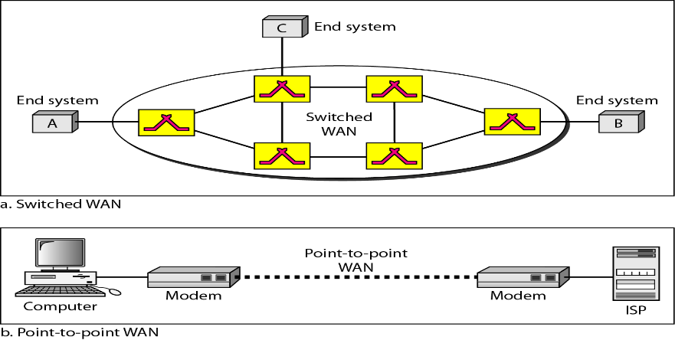
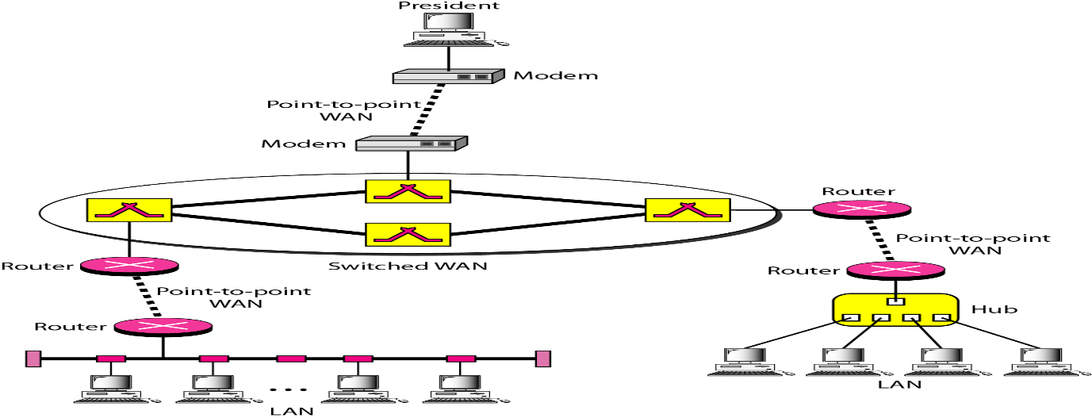
Categories of Networks
Local Area Networks (LANs)
  Short distances
  Designed to provide local interconnectivity
Wide Area Networks (WANs)
  Long distances
  Provide connectivity over large areas
Metropolitan Area Networks (MANs)
  Provide connectivity over areas such as a city, a campus
Notes:
1.#

Slide 11

INTERNET
An internet is two or more networks that can communicate with each other
The Internet is a collaboration of more than hundreds of thousands of interconnected networks
Figure-4: Hierarchical organization of the Internet
Notes:
1.#

Slide 12
PROTOCOLS
Protocol: Set of rules that govern data communications
Protocol determines what is communicated, how it is communicated and when it is communicated.
Elements of a Protocol
Syntax
  Structure or format of the data
  Indicates how to read the bits
Semantics
  Meaning of each section of the bits
  Knows which fields define what action
Timing
  When data should be sent
  Speed at which data should be sent or speed at which it is being received.
Notes:
1.#

Slide 13
Chapter 2
Network Models

Slide 14

LAYERED TASKS
Figure-1:Tasks involved in sending a letter

Slide 15

THE OSI MODEL
Established in 1947, the International Standards Organization (ISO) is a multinational body dedicated to worldwide agreement on international standards. An ISO standard that covers all aspects of network communications is the Open Systems Interconnection (OSI) model. It was first introduced in the late 1970s.
Figure-2: Seven layers of the OSI model

Slide 16
Physical Layer
Responsibilities of Physical Layer:
  Physical characteristics of interfaces and medium: Defines the characteristics of the interface between the devices and the transmission medium
  Representation of bits: Data consists of a stream of bits
  Data rate: Number of bits sent each second
  Synchronization of bits: Sender and receiver not only must use the same bit rate but also must be synchronized at the bit level
  Line configuration: Point-to-point configuration ( two devices are connected through a dedicated link) and Multipoint configuration ( link is shared among several devices)
  Physical topology: How devices are connected to make a network
  Transmission mode: Simplex, Half-duplex and Full-duplex

Slide 17

Data Link Layer
Responsibilities of Data Link Layer:
  Framing: Divides the stream of bits received from the network layer into manageable data units called frames
  Physical addressing: Adds a header to the frame to define the sender and receiver of the frame
  Flow control: If the rate at which the data are absorbed by the receiver is less than the rate at which data are produced in the sender
  Error control: Adds reliability to the physical layer by adding mechanisms to detect and retransmit damaged or lost frames
  Access control: When two or more devices are connected to the same link, data link layer protocols are necessary to determine which device has control over the link

Slide 18

Network Layer
Responsibilities of network layer:
  Physical addressing : Adds a header to the packet coming form the upper layer, includes the logical addresses of the sender and receiver
  Routing : When independent networks or links are connected to create internetworks or a large network, the connecting devices router or switch the packets to their final destination

Slide 19

Transport Layer
Responsibilities of transport layer:
  Service point addressing : Transport layer header adds a type of address called a service point address ( port address)
  Segmentation and reassembly : Message is divided into transmittable segments, with each segment containing a sequence number. These numbers enable the transport layer to reassemble the message correctly upon arriving at the destination and to identify and replace packets that were lost in transmission.
  Connection control: Transport layer can be either connectionless or connection oriented
  Flow control : Transport layer is responsible for flow control
  Error control : Transport layer is responsible for flow control

Slide 20
Session Layer and Presentation Layer
Responsibilities of Session Layer:
  Dialog control : The communication between two processes either half-duplex or full-duplex
  Synchronization : To synchronize the stream of data
Responsibilities of Presentation Layer:
  Translation: Presentation layer at the sender changes the information from its sender dependent format into a common format. At the receiving machine changes the common format into its receiver dependent format
  Encryption : Encryption means that the sender transforms the original information to another form and sends the resulting message out over the network
  Compression : Data compression reduces the number of bits contained in the information

Slide 21

Application Layer
Responsibilities of application layer:
  File transfer, access and management
  Mail services

Slide 22
TCP/IP PROTOCOL SUITE
Original TCP/IP protocol suite was defined as having four layers:
  Host-to-Network
  Internet
  Transport
  Application
However, when TCP/IP is compared to OSI, we can say that the TCP/IP protocol suite is made of five layers:
  Physical Layer
  Data Link Layer
  Network Layer
  Transport Layer
  Application Layer

Slide 23

TCP/IP and OSI Model

Slide 24


ADDRESSING
Four levels of addresses are used in an internet employing the TCP/IP protocols: Physical, Logical, Port, and Specific
Figure-3: Relationship of layers and addresses in TCP/IP

Slide 25
Chapter 3
Physical Layer

Slide 26

TRANSMISSION IMPAIRMENT
Signals travel through the transmission media, which are not perfect
Signals at the beginning of the medium is not the same as the signal at the end of the medium
What is sent is not what is received

Slide 27

Attenuation
Means loss of energy -> weaker signal
When a signal travels through a medium it loses energy overcoming the resistance of the medium
Amplifiers are used to compensate for this loss of energy by amplifying the signal.
Measurement of Attenuation
To show the loss or gain of energy the unit “decibel” is used.
dB = 10log₁₀P₂/P₁
P₁ - input signal
P₂ - output signal

Slide 28

Distortion
Means that the signal changes its form or shape
Distortion occurs in composite signals
Signals have different phases at the receiver than they did at the source

Slide 29

Noise
Unwanted something
Noise refers to any external and unwanted information that interferes with a transmission signal

Slide 30

Signal to Noise Ratio (SNR)
To measure the quality of a system the SNR is often used
It indicates the strength of the signal with respect to the noise power in the system
It is the ratio between two powers

